Slide 1


Robust Voice Activity Detection using DNN Approaches
Name: Parashar Kshitij
Project ID: SCSE23-0748
Supervisor: A/P Chng Eng Siong
Examiner: Dr. Josephine Chong
Date: 10th May 2024

Slide 2






Presentation Outline
Introduction
Literature Review
Methodology & Results
Conclusion & Future Recommendations

Slide 3
Audio Concepts
Pyannote, Silero, MarbleNet
Evaluation Metrics
ONNX
Contribution
Future Work
METHODOLOGY
&
RESULTS
INTRODUCTION
LITERATURE REVIEW
CONCLUSION
Background
Objective and Scope
Experiment 1
Experiment 2
Experiment 3
Experiment 4
Experiment 5

Slide 4
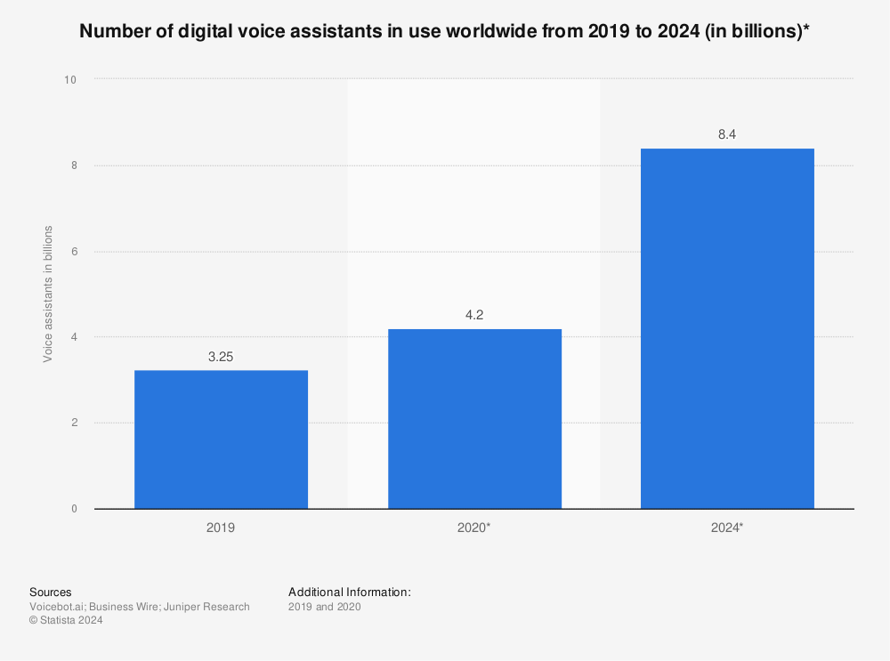
Introduction
Background
The number of digital voice assistants is projected to grow to 8.4 billion in 2024
F. Laricchia, Number of voice assistants in use worldwide 2019-2024, Mar. 2022. [Online]. Available: https : / / www . statista . com / statistics / 973815/worldwide-digital-voice-assistant-in-use/.

Slide 5
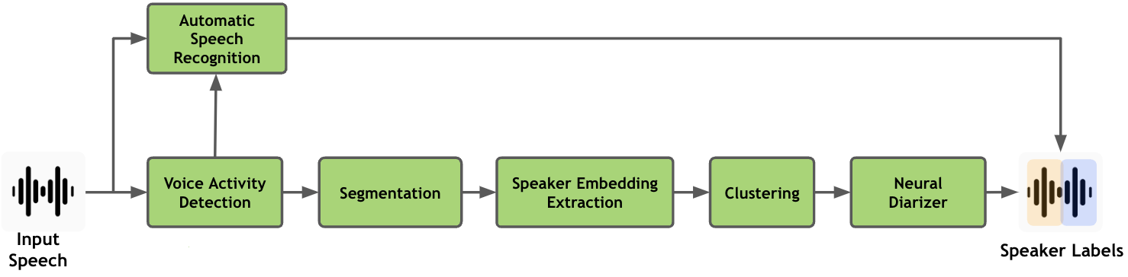
Introduction
Background
Purpose
Distinguish between speech and non-speech segments to improve the accuracy of diarization pipeline
Applications
Meeting transcription
Speaker identification
Voice-controlled devices
Approaches
Energy
DNN models
Hybrid methods
Typical Speaker Diarization Pipeline

Slide 6
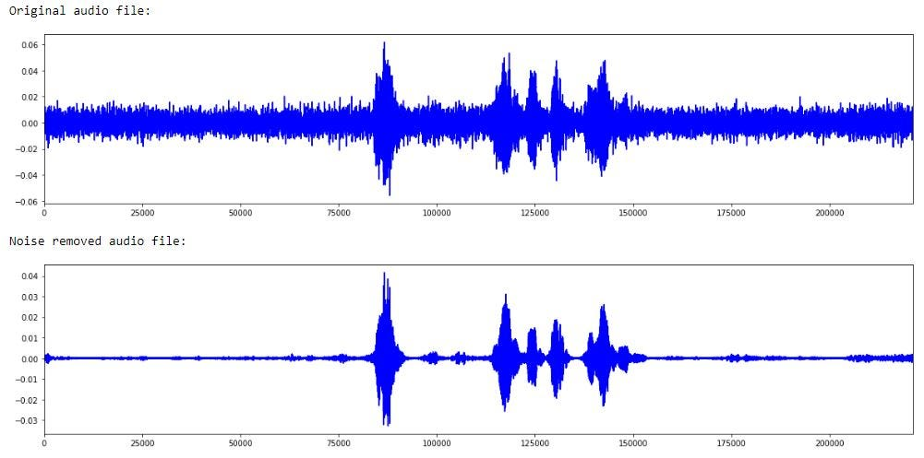
Introduction
Motivation
Background Noise
Noise interference challenges accurate speech detection.
Domain Adaptation
Adapting to diverse environments and recording conditions is crucial.
Real-time processing
Handling longer audio streams demands efficient methods.
Evaluation metrics and benchmarks¹
Standard evaluation metrics and benchmarks are lacking in VAD, hindering method comparison and assessment.
[1] S. Yadav, P. A. D. Legaspi, M. S. O. Alink, A. B. J. Kokkeler, and B. Nauta,“Hardware implementations for voice activity detection: Trends, challenges andoutlook,” IEEE Transactions on Circuits and Systems I: Regular Papers, vol. 70, no. 3, pp. 1083–1096, 2023

Slide 7
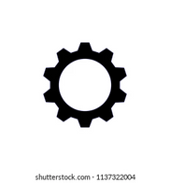

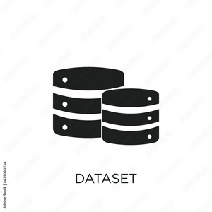

Introduction
}
Objectives & Scope
Models:
Pyannote
Silero
MarbleNet
Evaluate models based on:
Accuracy
Missing Detection
False Alarm
ROC-AUC score
Real Time Factor
Datasets:
DIHARD III
AliMeeting
Develop a robust VAD model
Scope: Single-channel far-field voice activity detection tasks

Slide 8
Audio Concepts
Pyannote, Silero, MarbleNet
Evaluation Metrics
ONNX
Summary
Contribution
Future Work
METHODOLOGY
&
RESULTS
INTRODUCTION
LITERATURE REVIEW
CONCLUSION
Background
Objective and Scope
Experiment 1
Experiment 2
Experiment 3
Experiment 4
Experiment 5

Slide 9
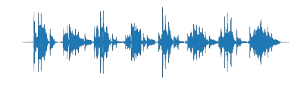
Literature Review
Audio Processing
Audio sampled at 16kHz

Slide 10
Literature Review
Frame
A frame is a single sample of an audio file.
Audio frames

Slide 11
Literature Review
Frame Step
Determines the overlap or spacing between any two consecutive frames
Audio frames with a smaller frame step

Slide 12
Literature Review
Chunk
A larger segment of audio data that encompasses multiple consecutive frames

Slide 13
Literature Review
Chunk

Slide 14
Literature Review
Chunk

Slide 15
Literature Review
Chunk

Slide 16
Literature Review
Chunk
chunk segmentation error
?

Slide 17
Literature Review
Stride & Overlap
Chunk 1
Chunk 2
stride
overlap

Slide 18
Literature Review
Evolution of VAD Architectures
Late 1990s – Early 2010s
Hidden Markov Models
2011 - 2017
Multi Layer Perceptron
2017 onwards
Long Short Term Memory
Gaussian Mixture Models
Convolutional Neural Network
Exploration of different features (MFCC, Mel)
Recurrent Neural Network
Bidirectional Long Short Term Memory
Notes:
Mel-frequency cepstral coefficients

Slide 19
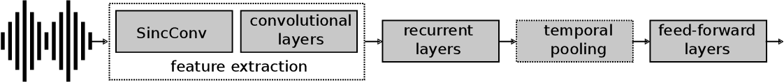
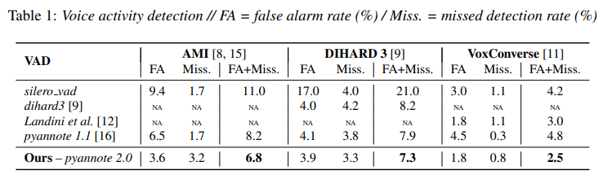
Literature Review
Pyannote
Feature Extraction: Employs SincNet to identify the most important features. Implements a bank of band-pass filters where low and high cutoff frequencies are learned
Architecture: LSTM (type of RNN) layers for modeling temporal dependencies, and a feedforward layer for predicting frame-level speech probabilities.
H. Bredin and A. Laurent, End-to-end speaker segmentation for overlap-aware resegmentation, 2021.

Slide 20
Literature Review
Silero
Feature Extraction: Employs Short-Time Fourier Transform (STFT) as a feature extraction technique.
Adaptable Sampling Rates: Works seamlessly with both 8kHz and 16kHz sampling rates, enhancing versatility.
Real-time Detection: Enables real-time voice activity detection by processing audio in manageable parts.
Architecture:
Encoder consisting of convolutional layers
Decoder with an LSTM layer
Convolutional and sigmoid layers for output.
S. Team, Silero VAD: Pre-trained enterprise-grade voice activity detector (VAD), number detector and language classifier, https : / / github . com / snakers4/silero-vad, 2021

Slide 21
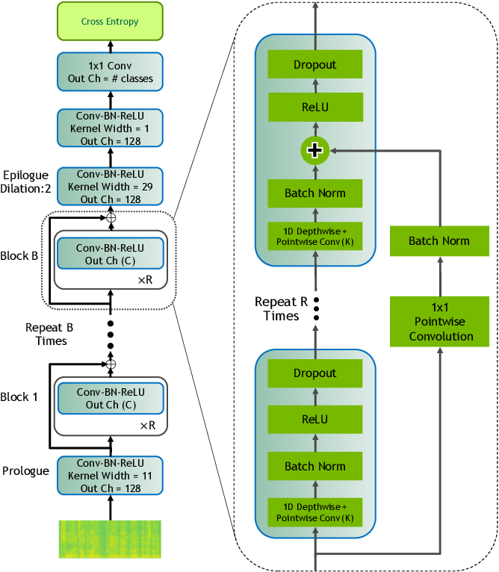
Literature Review
MarbleNet
Feature Extraction: uses Mel-Frequency Cepstral Coefficients (MFCC).
Architecture: Multiple CNN blocks.
F. Jia, S. Majumdar, and B. Ginsburg, Marblenet: Deep 1d time-channel separable convolutional neural network for voice activity detection, 2021.

Slide 22
Literature Review
Datasets
Parameters | AliMeeting² |  | DIHARD III (Full)³
 | Train | Eval | Train/Dev | Eval
Duration (in hours) | 104.75 | 4 | 34.15 | 33.01
# Recordings | 212 | 8 | 254 | 259
Overlap ratio (%) | 42.27 | 24.20 | 10.70 | 9.35
Language | Mandarin |  | English (Not all native speakers)
Domain | Meeting |  | Audiobooks, Broadcast Interview, Clinical, Court, Maptask, Meeting, Restaurant, Webvideo, etc. (11 in total)
Audio File Format | .WAV |  | .FLAC
Ground Truth Format | .TextGrid |  | .RTTM
[2] F. Yu, S. Zhang, Y. Fu, et al., “M2met: The ICASSP 2022 multi-channel multi-party meeting transcription challenge,” CoRR, vol. abs/2110.07393, 2021.
[3] N. Ryant, P. Singh, V. Krishnamohan, et al., The third DIHARD diarization challenge, 2021.

Slide 23


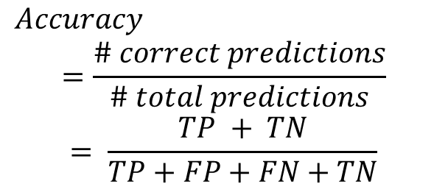
Literature Review
Evaluation Metrics
Abbreviations:
TP: True Positive
TN: True Negative
FP: False Positive
FN: False Negative
$Accuracy$
$$=\frac{\# correct predictions}{\# total predictions}$$
$$= \frac{TP + TN}{TP+FP+FN+TN}$$

Slide 24
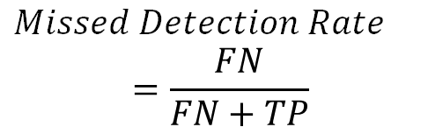
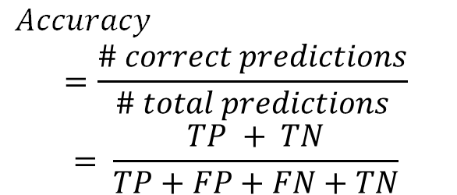
Literature Review
Evaluation Metrics
Abbreviations:
TP: True Positive
TN: True Negative
FP: False Positive
FN: False Negative
$Missed Detection Rate$
$$=\frac{FN}{FN+TP}$$
$Accuracy$
$$=\frac{\# correct predictions}{\# total predictions}$$
$$= \frac{TP + TN}{TP+FP+FN+TN}$$

Slide 25
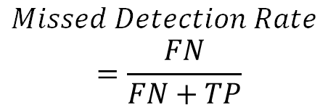
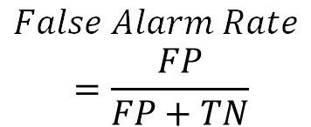
Literature Review
Evaluation Metrics
Abbreviations:
TP: True Positive
TN: True Negative
FP: False Positive
FN: False Negative
$False Alarm Rate$
$$=\frac{FP}{FP+TN}$$
$Missed Detection Rate$
$$=\frac{FN}{FN+TP}$$
$Accuracy$
$$=\frac{\# correct predictions}{\# total predictions}$$
$$= \frac{TP + TN}{TP+FP+FN+TN}$$

Slide 26
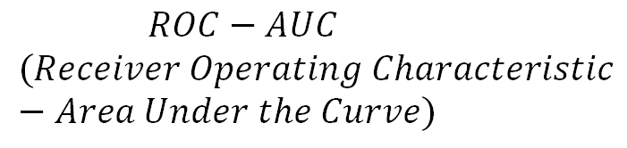
Literature Review
Evaluation Metrics
Abbreviations:
TP: True Positive
TN: True Negative
FP: False Positive
FN: False Negative
$False Alarm Rate$
$$=\frac{FP}{FP+TN}$$
$Missed Detection Rate$
$$=\frac{FN}{FN+TP}$$
$$ROC−AUC$$
$$(Receiver Operating Characteristic −Area Under the Curve)$$
$Accuracy$
$$=\frac{\# correct predictions}{\# total predictions}$$
$$= \frac{TP + TN}{TP+FP+FN+TN}$$

Slide 27
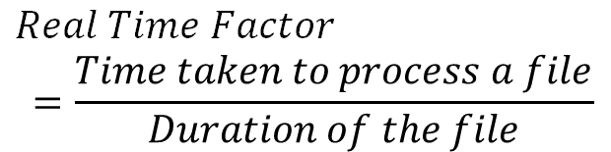
Literature Review
Evaluation Metrics
Abbreviations:
TP: True Positive
TN: True Negative
FP: False Positive
FN: False Negative
$False Alarm Rate$
$$=\frac{FP}{FP+TN}$$
$Missed Detection Rate$
$$=\frac{FN}{FN+TP}$$
$$ROC−AUC$$
$$(Receiver Operating Characteristic −Area Under the Curve)$$
$Accuracy$
$$=\frac{\# correct predictions}{\# total predictions}$$
$$= \frac{TP + TN}{TP+FP+FN+TN}$$
$Real Time Factor$
$$=\frac{Time taken to process a file}{Duration of the file}$$
Notes:
false positive is an error in binary classification in which a test result incorrectly indicates the presence of a condition
false negative is a test result which wrongly indicates that a condition does not hold

Slide 28
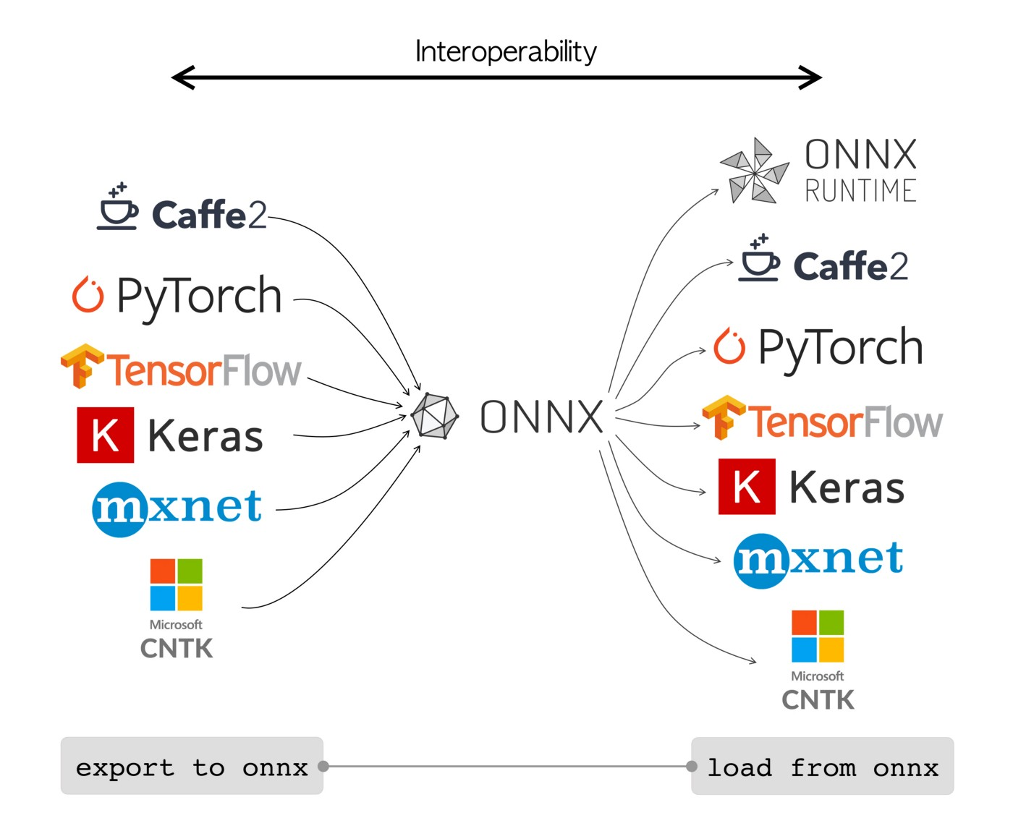
Literature Review
Open Neural Network Exchange

Slide 29
Audio Concepts
Pyannote, Silero, MarbleNet
Evaluation Metrics
ONNX
Summary
Contribution
Future Work
METHODOLOGY
&
RESULTS
INTRODUCTION
LITERATURE REVIEW
CONCLUSION
Background
Objective and Scope
Experiment 1
Experiment 2
Experiment 3
Experiment 4
Experiment 5

Slide 30
Overall Approach
Methodology
Survey performance of SOTA models
Understand the effects varying chunk sizes and strides
DIHARD III domain-wise analysis
Retrain best performing model
ONNX for inference
Operating Environment:
Aspire 2A GPU cluster provided by National Super Computing Centre (NSCC).
CPU: HPE Cray EX 2x AMD EPYC Millan 7713
GPU: NVIDIA A100-40G SXM

Slide 31

Methodology
Initial Inference
Pyannote was obtained by the replication of training procedure as described by Bredin et al. with chunk size 5s and stride as 4s.
Silero was obtained from the official Github repository made by the Silero team.
MarbleNet was obtained through a collaboration with AI Singapore.
Output
Model
Repeat inference for next chunk

Slide 32
Results
Initial Inference
DIHARD III | Model | Chunk size | Stride | Accuracy | MDR | FAR | ROC-AUC | RTF
 | Pyannote | 5s | 5s | 0.97 | 1.00 | 2.00 | 0.941 | 0.095
 | Silero |  |  | 0.83 | 11.1 | 6.10 | 0.795 | 0.022
 | MarbleNet |  |  | 0.77 | 1.60 | 21.6 | 0.536 | 0.011
AliMeeting | Model | Chunk size | Stride | Accuracy | MDR | FAR | ROC-AUC | RTF
 | Pyannote | 5s | 5s | 0.95 | 3.00 | 1.7 | 0.777 | 0.011
 | Silero |  |  | 0.74 | 21.9 | 4.0 | 0.624 | 0.038
 | MarbleNet |  |  | 0.92 | 8.7 | 4.8 | 0.732 | 0.047
Pyannote demonstrates superior performance compared to Silero and MarbleNet under the conditions of a 5-second chunk size and stride on both the DIHARD III and AliMeeting datasets.

Slide 33

Methodology
Effect of Varying Chunk Sizes
and Strides
Aim to investigate the impact of varying chunk sizes and strides on the performance of Pyannote, Silero, and MarbleNet.
Some important hyperparameters
Range of chunk sizes tested: 0.5s – 5s
Range of strides tested: 0.1s – 5s
Prediction threshold: 0.5
Dataset: DIHARD III Eval set

Slide 34
Results
Effect of Varying Chunk Sizes
and Strides
X Axis Legend:
(p, q): p is chunk size, q is stride
Conclusion: Pyannote exhibits the best performance with higher average evaluation metrics

Slide 35

Methodology
DIHARD III domain-wise analysis with Pyannote (5,4)
From Experiment 1 and 2, Pyannote is the best performing model.
Aim to understand the performance of Pyannote for different domains of DIHARD III
Domains of interest: Restaurant, Meeting and Webvideo
Notes:
Models perform poorly on domains with high background noise, high speech overlap, etc.

Slide 36
Results
DIHARD III domain-wise analysis with Pyannote (5,4)
Conclusion
Larger chunk size ⟹ Higher accuracy & ROC-AUC
For fixed chunk size, decreasing stride ⟹ decreasing accuracy & ROC-AUC (except restaurant)
Notes:
Models perform poorly on domains with high background noise, high speech overlap, etc.

Slide 37
Results
DIHARD III domain-wise analysis with Pyannote (5,4)
Restaurant | Chunk | Stride | Acc | MDR | FAR | ROC-AUC | RTF
 | 5s | 5s | 0.960 | 1.7 | 2.4 | 0.888 | 0.078
 | 1s | 1s | 0.886 | 7.4 | 4.0 | 0.776 | 0.076
 | 1s | 0.4s | 0.911 | 1.9 | 7.0 | 0.680 | 0.035
 | 0.5s | 0.5s | 0.840 | 10.8 | 5.3 | 0.704 | 0.070
 | 0.5s | 0.3s | 0.871 | 6.0 | 6.9 | 0.662 | 0.049
 | 0.5s | 0.2s | 0.887 | 3.1 | 8.1 | 0.628 | 0.032
Meeting | Chunk | Stride | Acc | MDR | FAR | ROC-AUC | RTF
 | 5s | 5s | 0.966 | 1.3 | 2.1 | 0.929 | 0.088
 | 1s | 1s | 0.941 | 2.3 | 3.7 | 0.875 | 0.074
 | 1s | 0.4s | 0.931 | 0.6 | 6.2 | 0.809 | 0.034
 | 0.5s | 0.5s | 0.913 | 3.5 | 5.2 | 0.821 | 0.070
 | 0.5s | 0.3s | 0.913 | 1.6 | 7.1 | 0.778 | 0.048
 | 0.5s | 0.2s | 0.909 | 0.7 | 8.4 | 0.747 | 0.032
For small chunk size and stride, decent performance for chunk size 1s and stride 0.4s is observed
Webvideo | Chunk | Stride | Acc | MDR | FAR | ROC-AUC | RTF
 | 5s | 5s | 0.947 | 1.7 | 3.6 | 0.917 | 0.080
 | 1s | 1s | 0.871 | 3.8 | 9.1 | 0.812 | 0.087
 | 1s | 0.4s | 0.848 | 9.1 | 14.1 | 0.747 | 0.030
 | 0.5s | 0.5s | 0.833 | 14.1 | 12.0 | 0.759 | 0.070
 | 0.5s | 0.3s | 0.827 | 12.0 | 15.0 | 0.721 | 0.048
 | 0.5s | 0.2s | 0.816 | 15.0 | 17.2 | 0.693 | 0.031
Audiobooks | Chunk | Stride | Acc | MDR | FAR | ROC-AUC | RTF
 | 5s | 5s | 0.985 | 0.4 | 1.1 | 0.973 | 0.091
 | 1s | 1s | 0.962 | 0.8 | 3.0 | 0.929 | 0.075
 | 1s | 0.4s | 0.946 | 0.1 | 5.3 | 0.883 | 0.029
 | 0.5s | 0.5s | 0.919 | 1.4 | 6.7 | 0.843 | 0.070
 | 0.5s | 0.3s | 0.905 | 0.5 | 9.0 | 0.797 | 0.049
 | 0.5s | 0.2s | 0.889 | 0.2 | 10.9 | 0.756 | 0.032
Notes:
Models perform poorly on domains with high background noise, high speech overlap, etc.

Slide 38

Methodology
Retraining Pyannote
Other Hyperparameters
Max. no. of epochs
Batch size
Chunk size (s)
stride (s)
Frame size (s)
Frame shift (s)
Optimiser
Learning rate
Max. Gradient Norm
Number of channels
Sample rate (Hz)
Aim to train Pyannote on different values of chunk sizes and strides
Model nomenclature format: Py (x, y)
Py: Pyannote
x: Training chunk size (s)
y: Training stride (s)
Layer | Hyperparameter
SincNet | stride
LSTM | hidden_size
 | num_layers
 | bidirectional
 | monolithic
 | dropout
Linear | hidden_size
 | num_layers

Slide 39
Results
Training Pyannote
Domain | Model | Acc | MDR | FAR | ROC-AUC | RTF
Restaurant | Py (5, 4) | 0.911 | 1.9 | 7.0 | 0.680 | 0.035
 | Py (1, 0.4) | 0.891 | 3.0 | 7.9 | 0.642 | 0.034
Webvideo | Py (5, 4) | 0.848 | 1.1 | 14.1 | 0.747 | 0.030
 | Py (1, 0.4) | 0.831 | 3.9 | 13.0 | 0.761 | 0.035
Meeting | Py (5, 4) | 0.931 | 0.6 | 6.2 | 0.809 | 0.034
 | Py (1, 0.4) | 0.848 | 0.9 | 14.2 | 0.596 | 0.034
Audiobooks | Py (5, 4) | 0.946 | 0.1 | 5.3 | 0.883 | 0.029
 | Py (1, 0.4) | 0.976 | 0.7 | 1..7 | 0.956 | 0.035
DIHARD III Eval set | Py (5, 4) | 0.920 | 0.6 | 7.4 | 0.821 | 0.029
 | Py (1, 0.4) | 0.920 | 1.8 | 6.2 | 0.846 | 0.034
1. Restaurant Domain: Py (5, 4) achieves higher accuracy (0.911) than Py (1, 0.4) (0.891), showing superior event detection performance.
2. Consistency Across Domains: Py (5, 4) consistently outperforms Py (1, 0.4) in Webvideo and Meeting domains, maintaining lower MDR and FAR values.
3. Chunk Size and Stride Impact: Larger chunk size and stride (Py (5, 4)) generally lead to better performance across domains.
4. Audiobooks Exception: Py (1, 0.4) achieves higher accuracy (0.976) than Py (5, 4) (0.946), indicating differences in generalization capabilities.

Slide 40
Results
Training Pyannote
Py (3, 2)
Chunk | Stride | Domain | Acc | MDR | FAR | ROC-AUC | RTF
3s | 3s | Restaurant | 0.723 | 24.8 | 2.9 | 0.731 | 0.035
 |  | Webvideo | 0.775 | 17.3 | 5.2 | 0.808 | 0.036
 |  | Meeting | 0.834 | 15.9 | 0.8 | 0.874 | 0.034
 |  | DIHARD III Eval set | 0.897 | 8.7 | 1.6 | 0.908 | 0.036
Py (1.5, 1)
Chunk | Stride | Domain | Acc | MDR | FAR | ROC-AUC | RTF
1.5s | 1.5s | Restaurant | 0.692 | 29.1 | 1.7 | 0.751 | 0.035
 |  | Webvideo | 0.767 | 19.1 | 4.2 | 0.807 | 0.036
 |  | Meeting | 0.831 | 16.3 | 0.6 | 0.878 | 0.034
 |  | DIHARD III Eval set | 0.882 | 10.5 | 1.2 | 0.903 | 0.036
Py (0.75, 0.5)
Chunk | Stride | Domain | Acc | MDR | FAR | ROC-AUC | RTF
0.75s | 0.75s | Restaurant | 0.645 | 34.3 | 1.1 | 0.742 | 0.035
 |  | Webvideo | 0.776 | 17.8 | 4.6 | 0.810 | 0.036
 |  | Meeting | 0.834 | 15.8 | 0.7 | 0.880 | 0.034
 |  | DIHARD III Eval set | 0.887 | 9.8 | 1.5 | 0.902 | 0.036
While larger configurations like Py (5, 4) yield superior performance in most challenging domains, smaller configurations like Py (1.5, 1) and Py (0.75, 0.5) may excel in less noisier domains.

Slide 41
Results
Training Pyannote
Comparing Py (5, 4) with Model K = Py (0.1875, 0.125)
Domain | Model | Acc | MDR | FAR | ROC-AUC | RTF
Restaurant | Py (5, 4) | 0.727 | 21.9 | 5.4 | 0.640 | 0.035
 | Model K | 0.622 | 36.1 | 1.8 | 0.714 | 0.035
Webvideo | Py (5, 4) | 0.772 | 9.8 | 13.0 | 0.702 | 0.030
 | Model K | 0.755 | 18.7 | 5.8 | 0.784 | 0.035
Meeting | Py (5, 4) | 0.809 | 13.7 | 5.4 | 0.755 | 0.034
 | Model K | 0.801 | 18.8 | 1.2 | 0.848 | 0.034
DIHARD III Eval set | Py (5, 4) | 0.842 | 7.3 | 8.5 | 0.754 | 0.029
 | Model K | 0.869 | 11.2 | 1.9 | 0.885 | 0.034
Models trained on small chunk sizes and strides may not perform optimally during inference with same configuration.
Py (5,4) demonstrates robustness and generalization across various chunk sizes and strides.
Larger chunk sizes, like in Py (5,4), provide more context to the BLSTM-based model, resulting in accurate predictions.
Inference chunk size and stride = 0.1875s

Slide 42

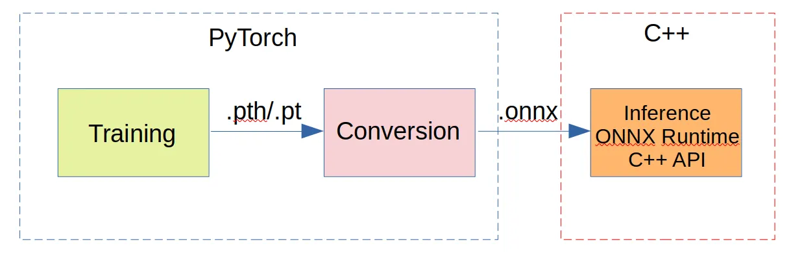
Methodology
ONNX for Inference
Aim to study the difference in inference times using Python and C++ based models
Model Configuration:
Model: Py (5,4)
Inference chunk size: 5s
Inference stride: 5s
Prediction threshold: 0.5
Output
Model
Repeat inference for next chunk

Slide 43
Results
ONNX for Inference
S.No. | Length of Audio | Python | C++
1 | 616.803s | 33.08s | 2s
2 | 49s | 1.81s | <1s
3 | 599.952s | 26.07s | 1.8s
4 | 368.43s | 15.29s | 1.2s
5 | 33hrs 28s | 58min 20s | 12min 3s
Significant and consistent reduction in inference time when using the C++ based model.
This scalability is crucial for real-time VAD systems that may need to process long audio recordings efficiently.

Slide 44
Audio Concepts
Pyannote, Silero, MarbleNet
Evaluation Metrics
ONNX
Contribution
Future Work
METHODOLOGY
&
RESULTS
INTRODUCTION
LITERATURE REVIEW
CONCLUSION
Background
Objective and Scope
Experiment 1
Experiment 2
Experiment 3
Experiment 4
Experiment 5

Slide 45
Conclusion
Contribution
01
Comprehensive evaluation of leading VAD models
02
Performed domain-wise analysis of Pyannote
03
Retrained Pyannote model with varying hyperparameters and developed a SOTA model
04
Explored strategies for enhancing scalability and production readiness

Slide 46
Conclusion
Future Work
01
Investigate ensemble learning techniques to enhance VAD performance.
02
Explore methods for adaptive VAD systems to dynamically adjust to changing environments.
03
Expand VAD models to multi-class classification for speaker counting problem
04
Incorporate transfer learning to leverage pre-trained models and improve performance.

Slide 47
Thank You!
Questions?

Slide 48
TEMPLATES

Slide 49

Robust Voice Activity Detection using DNN Approaches
Name: Parashar Kshitij
Project ID: SCSE23-0748
Supervisor: A/P Chng Eng Siong
Examiner: Dr. Josephine Chong
Date: 10th May 2024

Slide 50
Robust Voice Activity Detection using DNN Approaches
Name: Parashar Kshitij
Supervisor: Assoc. Prof. Chng Eng Siong
Examiner: Dr. Josephine Chong
Project ID: SCSE23-0748
Date: 10th May 2024

